Slide 1




Group 6
Food Deserts
In
Topeka, KS
Zach Wilson, Mark Messick, Ben Anderson, Annie Di Persio

Slide 2

Data Analysis for United Way
z
“United Way of Greater Topeka brings together people, companies and nonprofits to create positive sustainable change in our community. We work to solve issues no single donor, charity, or government agency can handle alone. By focusing on education, financial stability and health, we help more children graduate and get stable jobs, help families become financially stable and improve the overall health of our community.”
https://unitedwaytopeka.org/

Slide 3

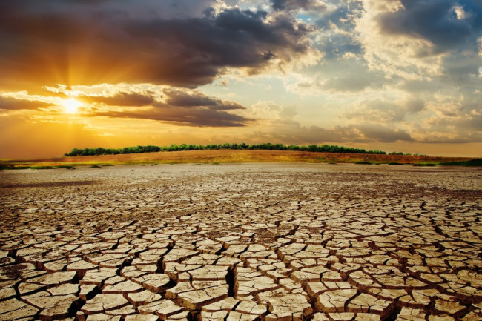
Hypothesis:
In areas with higher median household income, there will be more food resources available in that area. In areas with lower median income, there will be fewer resources available in that area.
Leads to

Slide 4
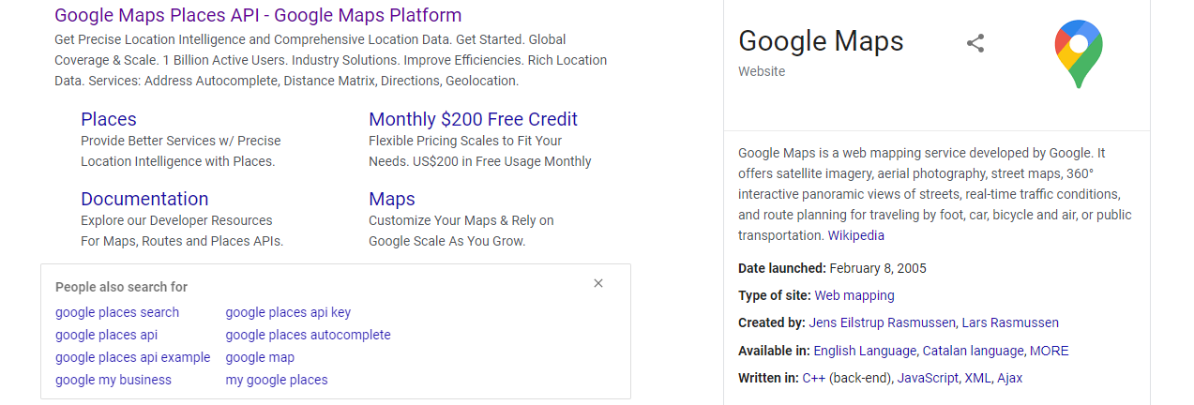
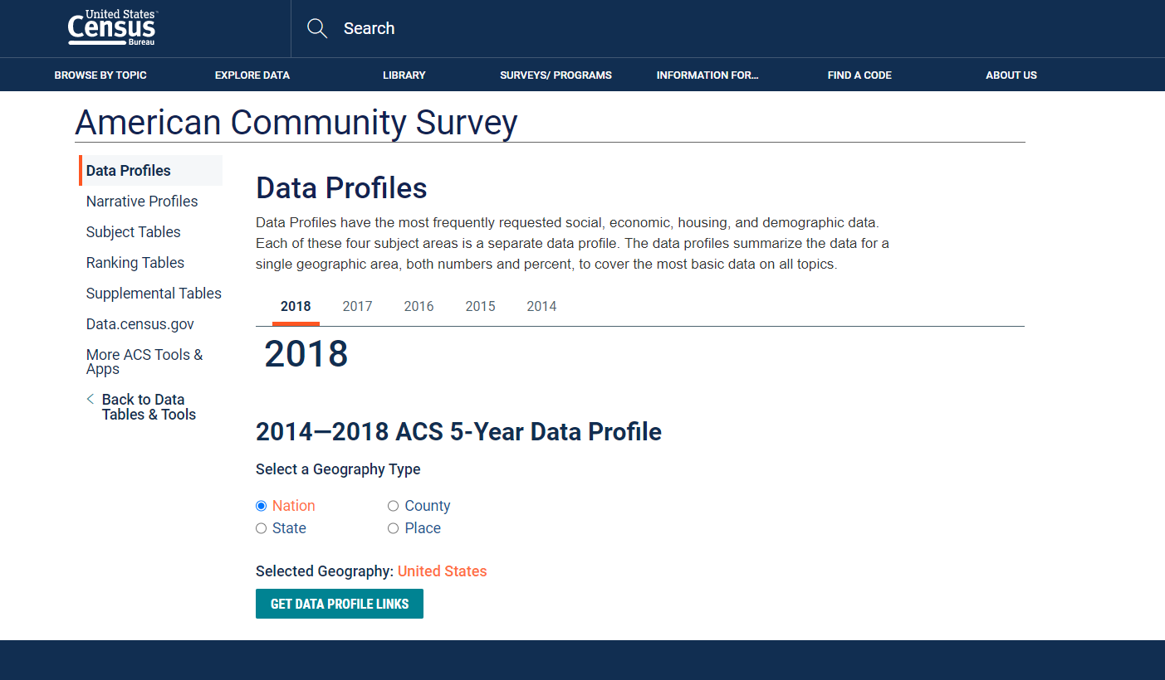
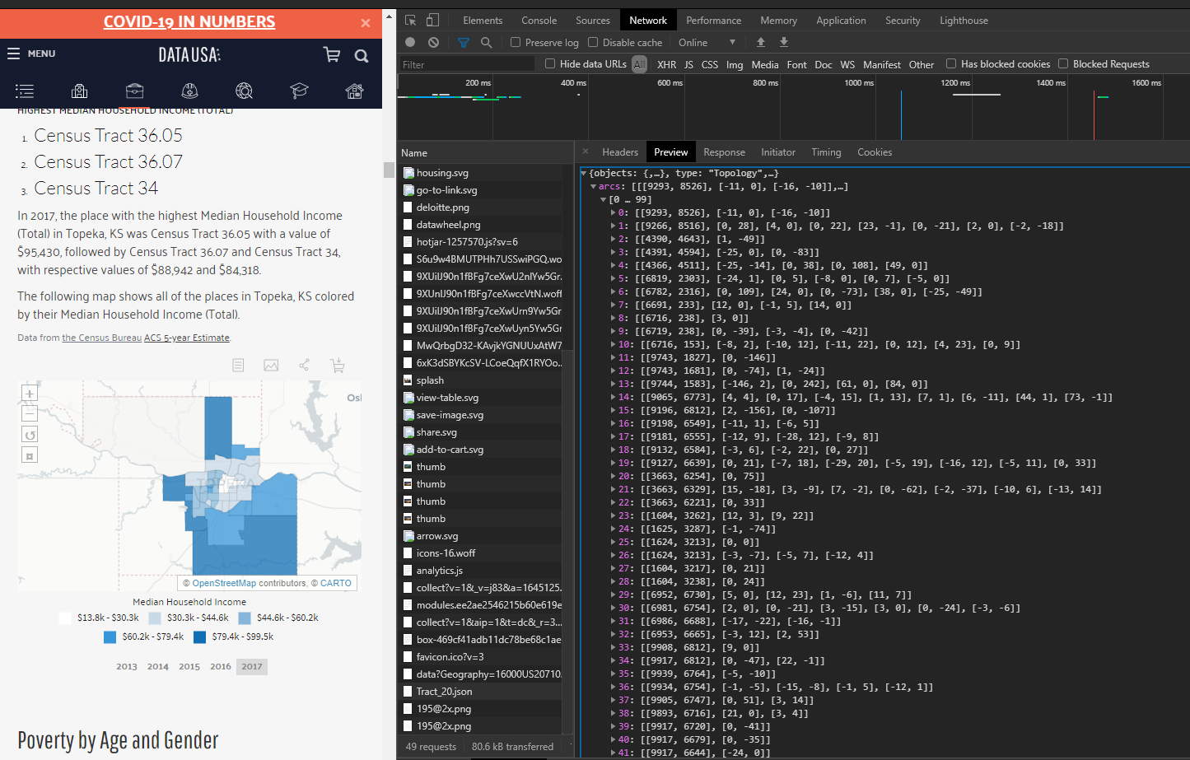
Data Round Up
Google Places API
Census Bureau American Community Survey
Ben did it so it must be alright
https://www.census.gov/acs/www/data/data-tables-and-tools/data-profiles/
https://datausa.io/profile/geo/topeka-ks/

Slide 5
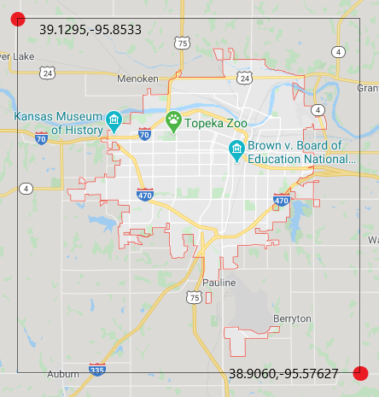
The Area

Slide 6
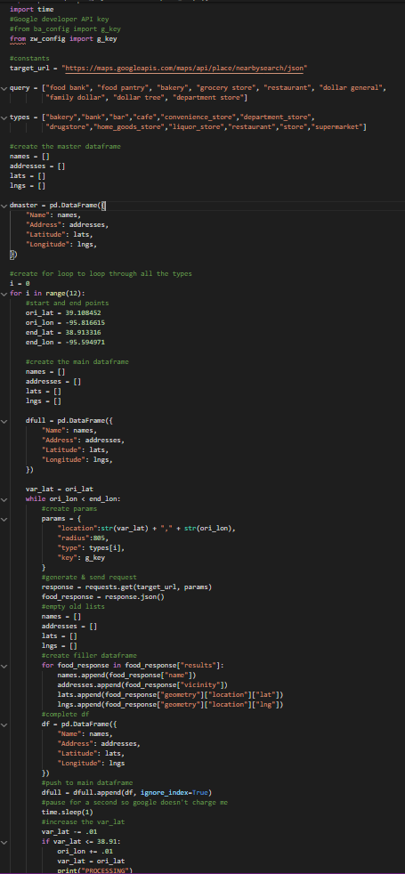

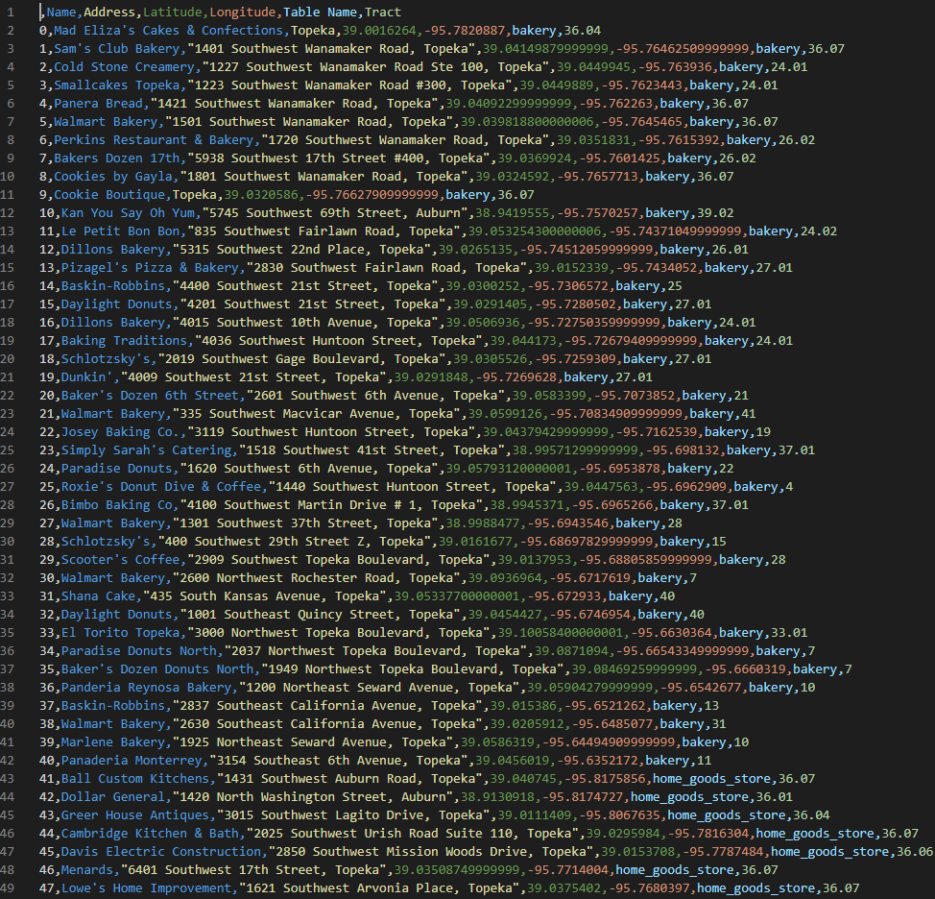
The Data
​The Master
Pulled data from Google Places API
The Code
places_scrape.py
clean.py
Master_maker.py
The Product

Slide 7
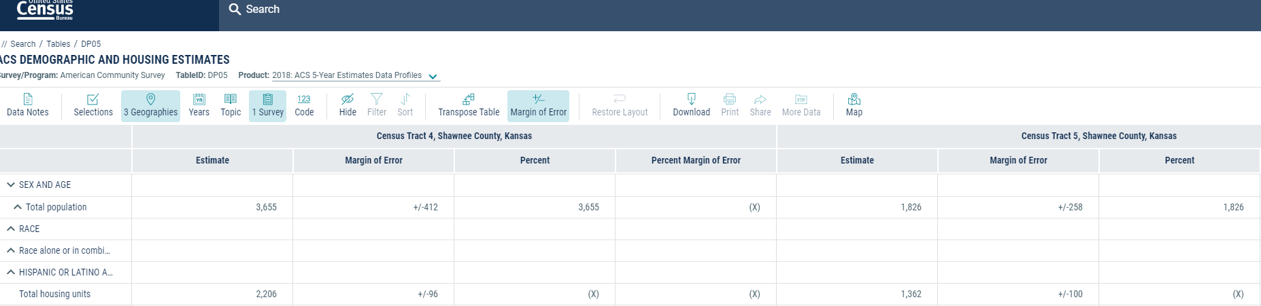
More Data
We also pulled Census Data for the population and housing
https://data.census.gov/cedsci/table?d=ACS%205-Year%20Estimates%20Data%20Profiles&table=DP05&tid=ACSDP5Y2018.DP05&g=0400000US20_1600000US2071000_0500000US20177.140000&hidePreview=true

Slide 8
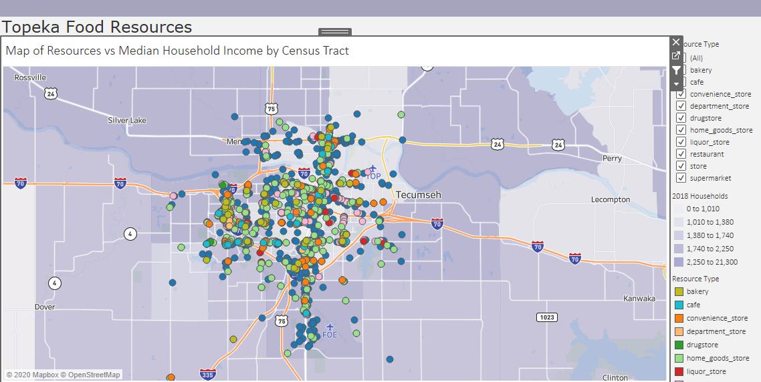
Visualization
https://public.tableau.com/profile/adipersio#!/vizhome/TopekaFoodResouces/Dashboard

Slide 9
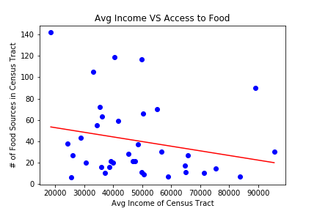
Machine Learning
Using linear regression to look for correlation:
R-Squared: 0.05

Slide 10
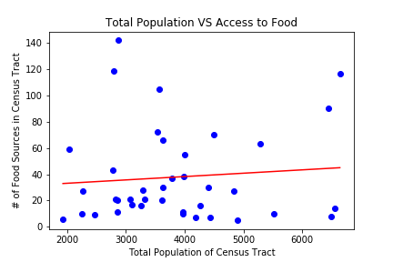
Machine Learning
Looking at other variables:
R-Squared: 0.008

Slide 11
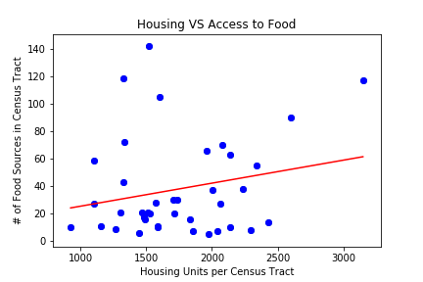
Machine Learning
Looking at other variables:
R-Squared: 0.04

Slide 12
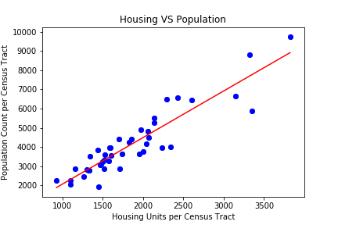
Machine Learning
Quick check to make sure the model is working…
R-Squared: 0.839

Slide 13
Conclusion
Original Hypothesis:
Outcome:
If a given area has a higher income, then more grocers are to be found in said area.
Validation of the null hypothesis.

Slide 14
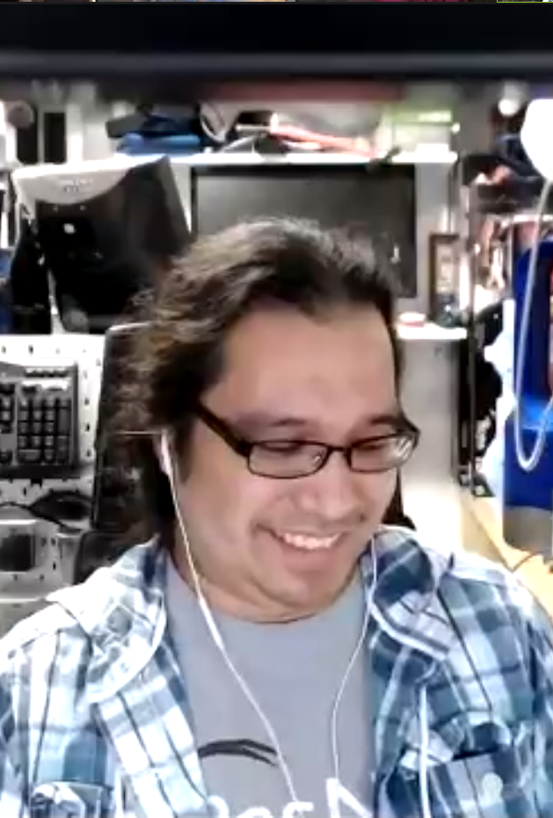
Thanks to Ben and the TAs for all the help and support!
z

